Slide 1



Header Compression in PDCP
To analyse header compression mechanisms in PDCP and their impact

Slide 2

CONTENTS
Introduction
Header compression in PDCP
PDCP (Packet Data Convergence Protocol)
Need for Header Compression
Header Compression Techniques
Robust Header Compression (ROHC)
Stateless Header Compression (SHC)
Significance of Header Compression
Performance Evolution
Challenges and Considerations
Code
Output

Slide 3

Group 2 Members
CHANDANA BAYYAPUNENI
LAKSHMI PRASANNNA TURLAPATI
NIHARIKA GUNTURI
RAHUL KUMAR MAHENDRA
SANDHYA YADAV
SAURABH ROY

Slide 4

Introduction
Welcome to our presentation on "Header Compression in PDCP in 5G NR Technology." In this presentation, we will explore the critical role of header compression in enhancing network efficiency within the 5G New Radio (NR) environment.
Header Compression is a technique used to minimize the size of headers in data packets, which is essential for optimizing data throughput and reducing latency. By compressing headers, we can reduce the bandwidth consumed by protocol headers, allowing more room for user data and improving overall network performance.

Slide 5
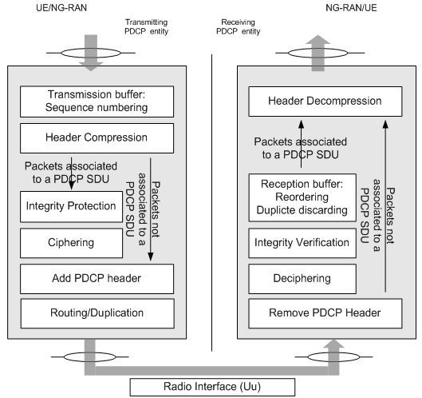
Header Compression in PDCP
Introduction:
Header compression reduces the size of headers in data packets, enhancing network efficiency.
This technique is critical in 5G NR to minimize overhead and optimize data throughput.
Role and Significance:
Efficiency: Decreases the bandwidth consumed by protocol headers, allowing more room for user data.
Latency: Reduces the time required for data transmission by minimizing header size.
Aim:
To analyze header compression mechanisms in PDCP and their impact on 5G NR performance based on 3GPP standards.
Figure No.1: Header Compression in PDCP

Slide 6
PDCP (Packet Data Convergence Protocol)
Definition:
PDCP is a layer in the 5G NR architecture designed for header compression, encryption, and integrity protection of user data.
Role in Protocol Stack:
Layer Positioning: Situated between the RLC (Radio Link Control) and SDAP (Service Data Adaptation Protocol) layers.
Functions:
Header Compression: Reduces overhead by compressing headers.
Encryption/Decryption: Provides security for data.
Integrity Protection: Ensures data integrity and correctness.
3GPP Specifications:
3GPP TS 38.323: "NR; Packet Data Convergence Protocol (PDCP) specification" (Details PDCP functionalities and header compression techniques).

Slide 7
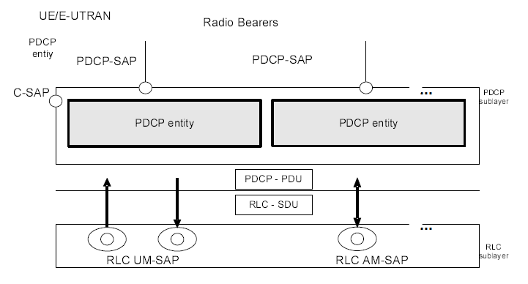
Figure No.2: PDCP Layer, Structure View

Slide 8

Need for Header Compression
Reducing Overhead:
Headers can be a significant portion of packet size, especially in high-frequency transmissions.
Overhead Reduction: By compressing headers, the payload size is maximized.
Addressing Overhead Issues:
High Header Size: Large headers relative to the payload can lead to inefficient bandwidth utilization.
Impact: Increased network load and reduced effective data transmission rates.
Benefits:
Efficiency: Improved use of network bandwidth.
Latency: Faster data transmission due to smaller header sizes.

Slide 9

Header Compression Techniques
Robust Header Compression (ROHC):
Overview: Designed to handle the compression of IP, UDP, and RTP headers. Particularly useful in high-speed networks.
3GPP Specifications:3GPP TS 36.323: Details ROHC's implementation in 5G NR.
Stateless Header Compression (SHC):
Overview: Compresses headers without maintaining state information, using fixed and dynamic dictionaries.
3GPP Specifications:3GPP TS 38.323: Includes SHC for specific use cases.

Slide 10
Robust Header Compression (ROHC)
Explanation:
Context-Based Compression: ROHC uses previously transmitted header information to predict and compress current headers.
Principles:
Context-Based Approach: Maintains a context of previously seen headers to
achieve high compression ratios.
ROHC Profiles:
IP/UDP/RTP Profile: Compresses headers for real-time applications, reducing overhead for streaming data.
TCP Profile: Compresses TCP headers, improving efficiency for reliable data transmission.
Detailed Process:
Initialization: Sets up context for new connections.
Compression: Applies context-based compression algorithms.
Decompression: Reconstructs headers at the receiver using context.

Slide 11
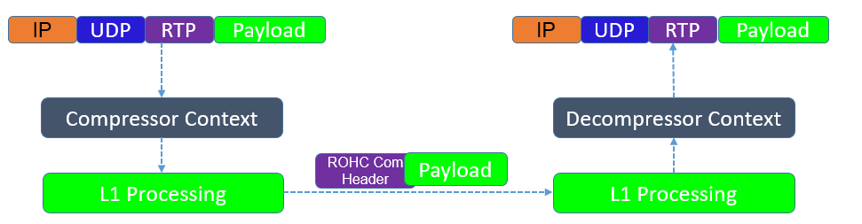
Figure No.3: Robust Header Compression (ROHC)

Slide 12
Code Snippet/Algorithm:
// ROHC Compression Algorithm Example
void compressROHC(Header header, Context context) {
if (contextExists(context)) {
// Use stored context to compress header
applyContextCompression(header, context);
} else {
// Initialize context if not available
initializeContext(header, context);
}
}

Slide 13

Stateless Header Compression (SHC)
Explanation:
Dictionary-Based Compression: SHC uses predefined dictionaries to compress headers, without maintaining state information.
Principles:
Fixed Dictionary: A set of standard rules for common header fields.
Dynamic Dictionary: Adapts based on the header fields observed during transmission.
Detailed Process:
Dictionary Lookup: Identifies header fields using predefined dictionaries.
Compression: Applies compression based on dictionary entries.
Decompression: Reconstructs original headers using the dictionary at the receiver.

Slide 14
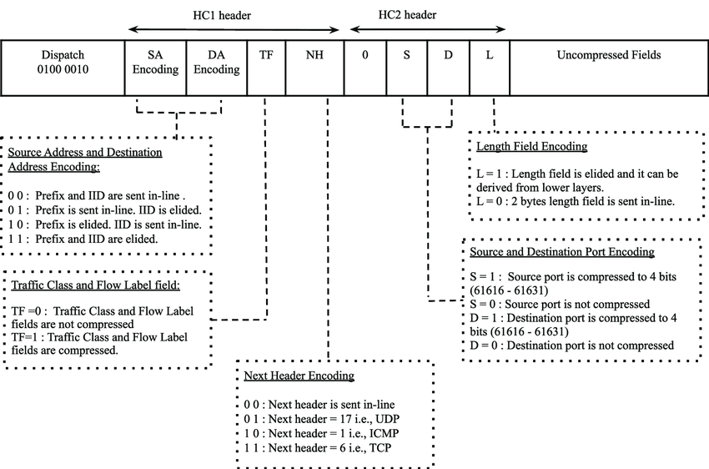
Figure No.4: Stateless Header Compression (SHC)​

Slide 15
Code Snippet/Algorithm:
// SHC Compression Algorithm Example
void compressSHC(Header header, Dictionary dict) {
if (isInDictionary(header, dict.fixed)) {
// Compress using fixed dictionary
applyFixedDictionaryCompression(header, dict.fixed);
} else {
// Use dynamic dictionary for compression
applyDynamicDictionaryCompression(header, dict.dynamic);
}
}

Slide 16
Significance of Header Compression in PDCP:
Efficiency: Reduced Overhead: By compressing the header, less data is sent over the network. This reduction in overhead means that more of the available bandwidth can be used for actual data transmission. Improved Throughput: With less overhead, the network can handle more data packets in the same amount of time, leading to higher throughput.
Latency Reduction: Faster Transmission: Smaller packets can be transmitted more quickly across the network, reducing the time it takes for data to travel from the sender to the receiver. Enhanced User Experience: Lower latency means that applications that require real-time communication, such as video calls or online gaming, perform better with less lag.

Slide 17
Performance Evaluation
Evaluation Metrics:
Compression Ratio: Measures the reduction in header size relative to the original size.
Latency: Impact of compression on the time required to transmit data.
Throughput: Increase in data capacity due to reduced header sizes.
Impact:
ROHC: Typically provides a higher compression ratio and is suited for high-speed data transmissions.
SHC: Provides a simpler approach to header compression with less overhead but potentially lower compression
ratios.
Statistics/Data:
3GPP TS 36.323: Provides performance metrics and evaluation results for ROHC and SHC.
Example Data: ROHC: Compression ratios of up to 80% for IP/UDP/RTP headers.
SHC: Typically achieves lower compression ratios but simplifies implementation.

Slide 18
Challenges and Considerations:
Complexity:
Compression Algorithms: The algorithms used for header compression must be efficient and effective, ensuring that the compression and decompression processes do not introduce delays.
Error Handling: If a compressed header is received incorrectly, it could lead to data being misinterpreted or lost, so error handling is crucial.
Compatibility:
Interoperability: The devices on both ends of the communication need to support the same header compression techniques for the process to work seamlessly.

Slide 19

Code for ROHC
ROHC.cc

Slide 20
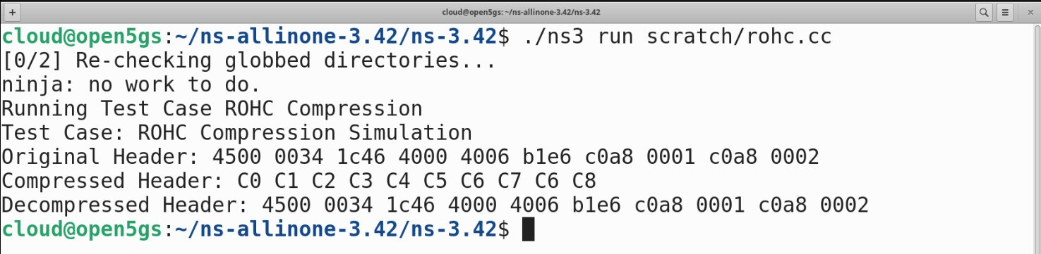
Output for ROHC

Slide 21

Code for SHC
SHC.cc

Slide 22
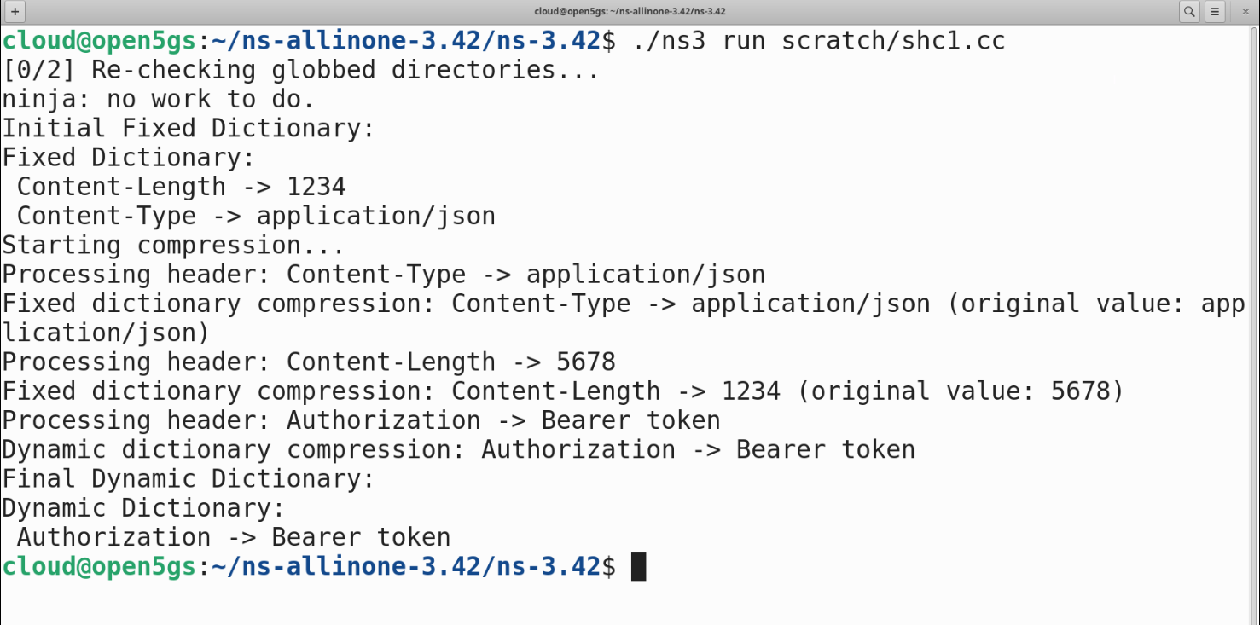
Output for SHC

